Slide 1
Study of two-particle response and phase changes in strongly correlated systems using Dynamical Mean Field Theory
Bismayan Chakrabarti
Dissertation defense
Supervisor: Prof. Kristjan Haule

Slide 2
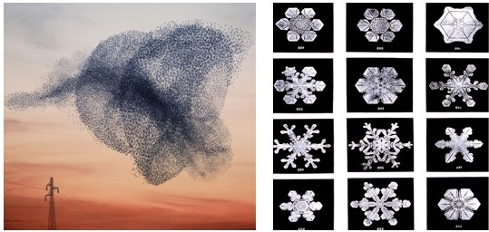
Condensed Matter- The study of Emergence
Traditional guiding principle of western Science- Reductionism
Emergence: Collections of entities exhibit properties not trivially understood from properties of individual constituents (More is different – P.W. Anderson ).
Condensed Matter: The study of emergent phenomenon in material systems

Slide 3
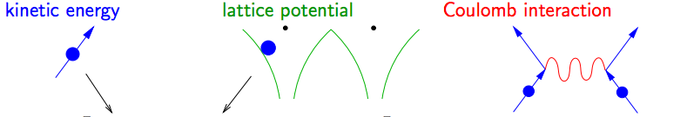
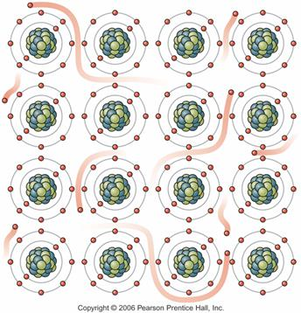

Can we understand macroscopic systems?
Fundamental equation governing the physics of all materials known in principle - Schrodinger Equation:
Can’t solve for macroscopic systems even with most powerful computers. Too many degrees of freedom (~10^23) connected due to interaction term
We must find efficient approximation schemes to make calculations computationally tractable
$$H=E_{nuc}+\sum_{i}{\left(\frac{∇_{i}^{2}}{2m_{e}}+V_{ext}(r_{i})\right)}+ \frac{1}{2}\sum_{i≠j}{\frac{1}{|r_{i}−r_{j}|}}$$

Slide 4
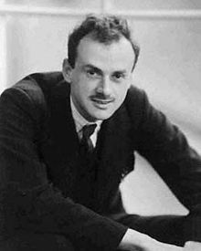
The underlying physical laws necessary for the mathematical theory of a large part of physics and the whole of chemistry are thus completely known, and the difficulty is only that the exact application of these laws leads to equations much too complicated to be soluble. It therefore becomes desirable that approximate practical methods of applying quantum mechanics should be developed, which can lead to an explanation of the main features of complex atomic systems without too much computation-Paul Dirac (1929)

Slide 5
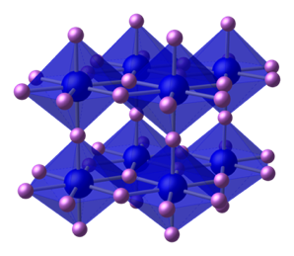
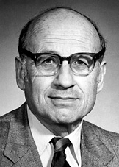

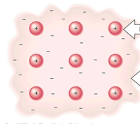
Weakly correlated materials
Materials with open s or p shells – Weak electronic Correlations.
Landau Fermi Liquid Theory works well.
Density Functional Theory (DFT) extremely successful even with simplistic treatment of electronic correlations.
Materials with open d or f shells:
More localized electrons! Stronger Electronic Correlations
DFT Fails !
Must formulate alternate methods
Not known exactly, approximations like LDA
DFT (LDA)
To get e⁻-e⁻ correlation each point in space
is mapped to electron gas problem
$$E_{DFT}\left[ρ\right]=E_{Kin}+E_{H}\left[ρ\right]+E_{XC}[ρ]$$

Slide 6
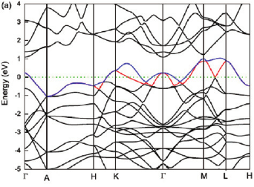
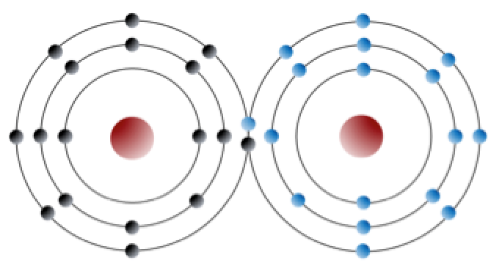
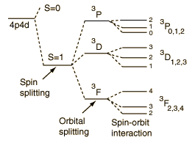
Strongly correlated systems
Interesting Physics due to interplay of localization/itineracy
Itineracy
Interplay of itineracy/ correlations
Very Large Correlations
Band Theory/DFT
Strongly Correlated Materials
(interacting) Atomic Physics
Metal-insulator transition
High Tc superconductivity
Heavy fermions.

Slide 7
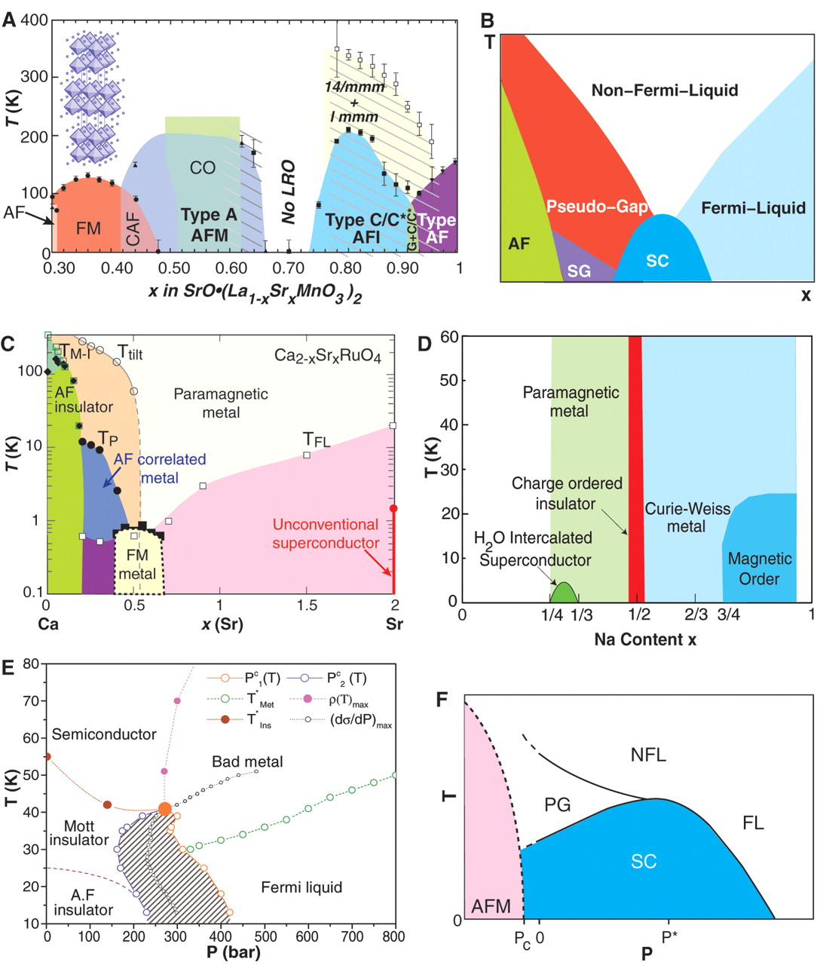
Strongly correlated systems
Can have highly complex phase diagrams
Bilayer Manganites
High T_{c} superconductors
Single layer
Ruthenates
Copper Oxides
Source: Science 08 Jul 2005: Vol. 309, Issue 5732, pp. 257-262

Slide 8

The DMFT approximation
Simulating strongly correlated systems hard: Solve true many body equation?
No! Use Dynamical Mean Field Theory (DMFT)
Lattice with strongly correlated atoms
Each correlated atom mapped to Quantum impurity Problem with self consistent Bath
Computational impurity solvers exist!
Exact in infinite dimensional limit

Slide 9
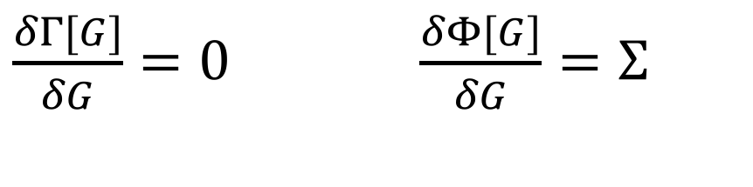
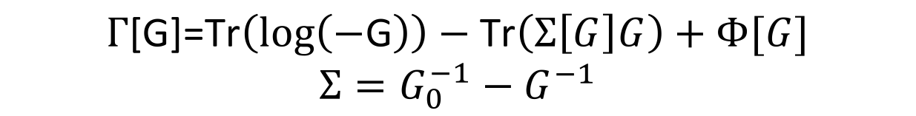
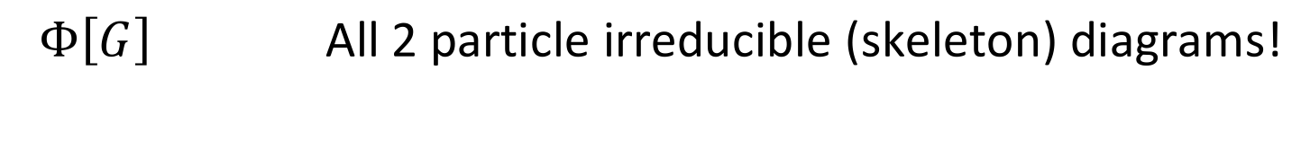
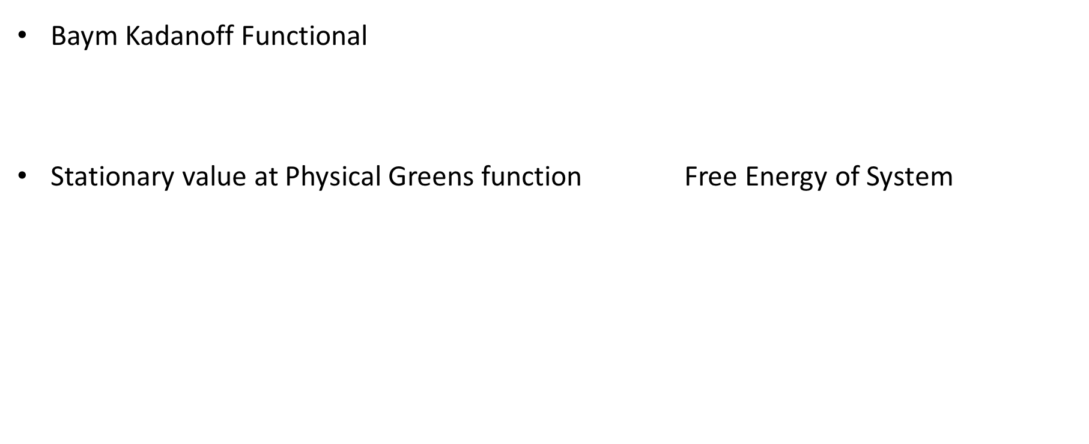
The DMFT approximation: An alternative approach
Luttinger-Ward Functional
Baym Kadanoff Functional
Stationary value at Physical Greens function Free Energy of System
$$Γ\text{[}\text{G}\text{]=}\text{Tr}\left(\log\left(−\text{G}\right)\right)−\text{Tr}\left(Σ\left[G\right]G\right)+Φ[G]$$
$$Σ=G_{0}^{−1}−G^{−1}$$
$\frac{δΓ[G]}{δG}=0$ $\frac{δΦ[G]}{δG}=Σ$
$$Φ\left[G\right] \text{All}\text{ 2 }\text{particle} \text{irreducible}\text{ (}\text{skeleton}\text{) }\text{diagrams}\text{!}$$

Slide 10

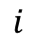
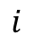
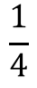
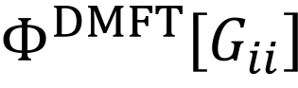
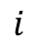
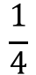
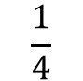
Full Luttinger-Ward Functional:
DMFT Approximation- Replace all Greens functions by Local (on correlated atom) Greens functions
$$Φ\left[G\right]$$
$$\frac{1}{2}$$
$$\frac{1}{2}$$
$$\frac{1}{4}$$
$$\frac{1}{4}$$
$$i$$
$$i$$
$$i$$
$$Φ^{DMFT}\left[G_{ii}\right]$$
$$\frac{1}{2}$$
$$\frac{1}{2}$$
$$\frac{1}{4}$$
$$\frac{1}{4}$$
$$i$$
$$i$$
$$i$$
$$i$$
$$i$$
$$i$$
$$i$$
$$i$$
$$i$$
$$i$$
i : correlated site on the lattice
$$i$$
Self Energy Becomes Local

Slide 11
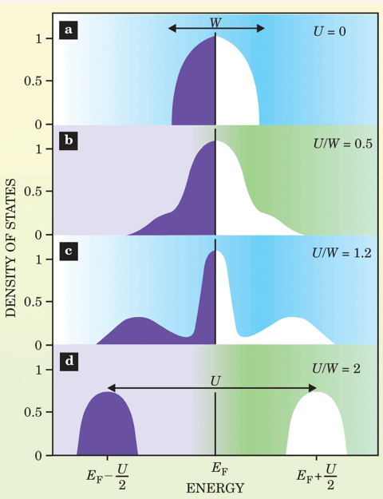
Landmark Early success of DMFT: Elucidating the One Band Hubbard Model
A. Georges, G. Kotliar, W. Krauth and M.J Rozenberg, Rev. Mod Phys. 68,13 (1996)

Slide 12
Merging DFT with DMFT
DMFT good at dealing with local correlations: treat d and f shells
Too computationally expensive to treat all orbitals
DFT excellent for weakly correlated orbitals
Computationally cheap but can’t simulate correlated orbitals
Combine them DFT+DMFT : State of the art method to perform ab initio simulations of correlated materials
DFT
DFT+DMFT
DMFT
$$Γ\text{[}\text{G}\text{,}ρ\text{]=}\text{Tr}\left(\log\left(−\text{G}\right)\right)−\text{Tr}\left(Σ\left[G\right]G\right)+E_{DFT}^{H+XC}\left[ρ\right]+Φ\left[G_{loc}\right]−Φ_{DC}[ρ_{loc}]$$

Slide 13
DFT+DMFT
Allows us to perform ab-initio simulations of actual material systems with open d or f shell elements, not resorting to mere model calculations
Allows for finite temperature simulations unlike DFT
State of the art impurity solvers allow a wide variety of experimental observables to be calculated – Comparison with experiment
Caveats-
Can be computationally expensive (f-shell elements like Pu require hundreds of thousands of computer hours)
For some impurity solvers, require analytic continuation

Slide 14
Selected Research Projects using DMFT

Slide 15
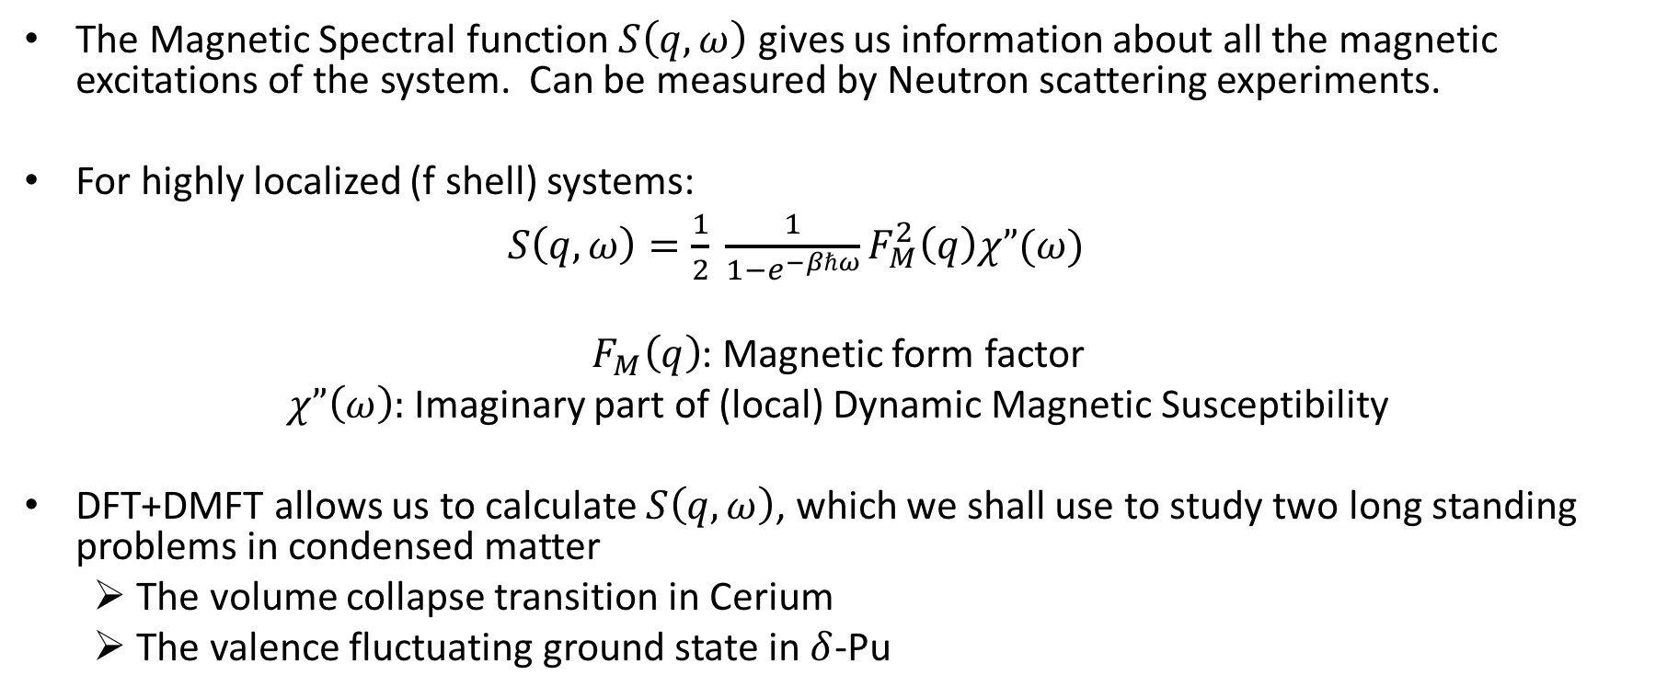
Calculation of Magnetic Spectral function
The Magnetic Spectral function $S\left(q,ω\right)$ gives us information about all the magnetic excitations of the system. Can be measured by Neutron scattering experiments.
For highly localized (f shell) systems:
$S\left(q,ω\right)=\frac{1}{2} \frac{1}{1−e^{−βℏω}}F_{M}^{2}\left(q\right)χ”(ω)$
$F_{M}\left(q\right)$: Magnetic form factor
$χ”\left(ω\right):$Imaginary part of (local) Dynamic Magnetic Susceptibility
DFT+DMFT allows us to calculate $S\left(q,ω\right)$, which we shall use to study two long standing problems in condensed matter
The volume collapse transition in Cerium
The valence fluctuating ground state in $δ$-Pu

Slide 16
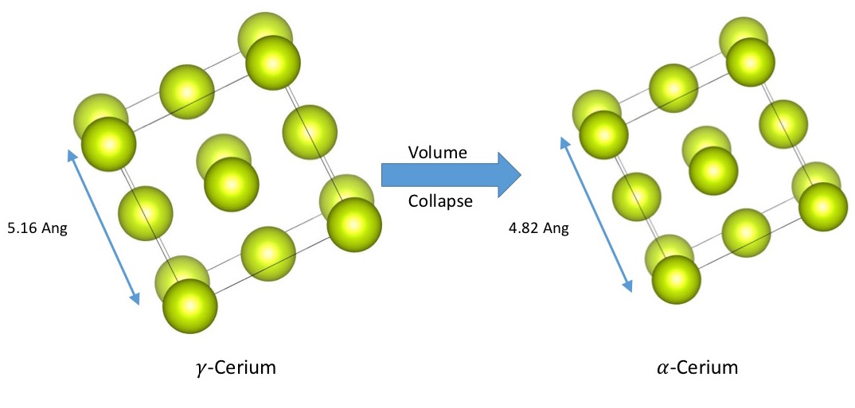
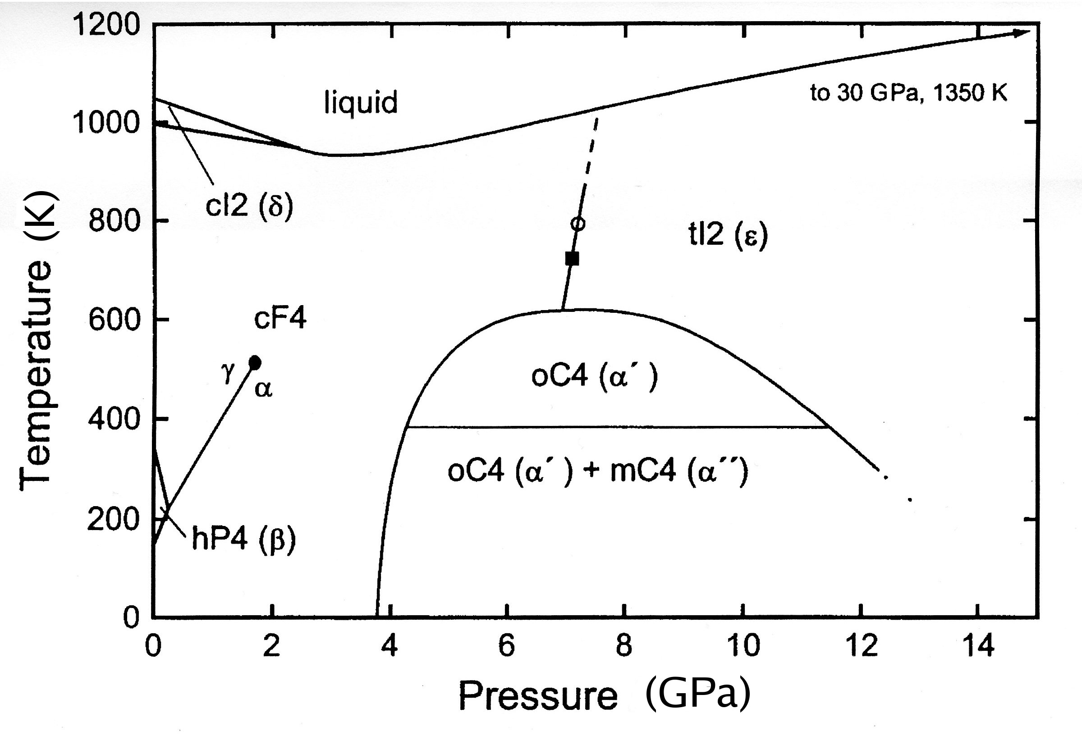
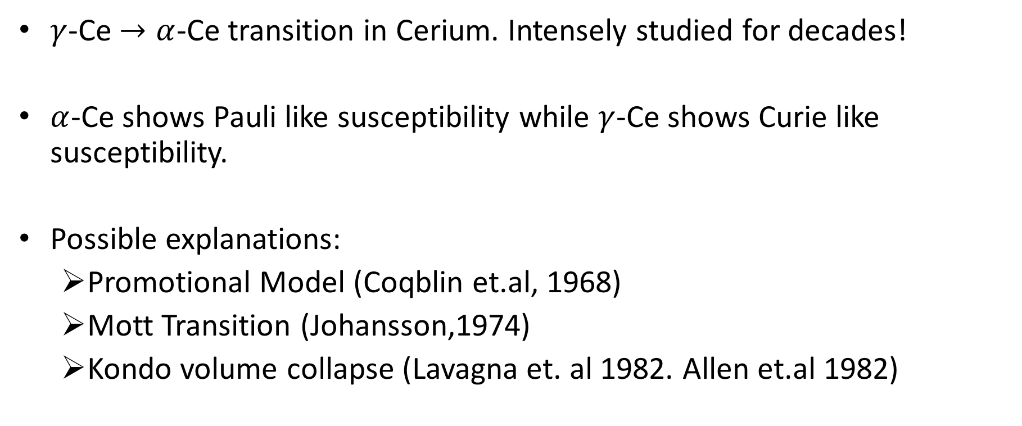
Volume Collapse transition in Cerium
$γ$-Ce $→α$-Ce transition in Cerium. Intensely studied for decades!
$α$-Ce shows Pauli like susceptibility while $γ$-Ce shows Curie like susceptibility.
Possible explanations:
Promotional Model (Coqblin et.al, 1968)
Mott Transition (Johansson,1974)
Kondo volume collapse (Lavagna et. al 1982. Allen et.al 1982)
Increase Pressure

Slide 17
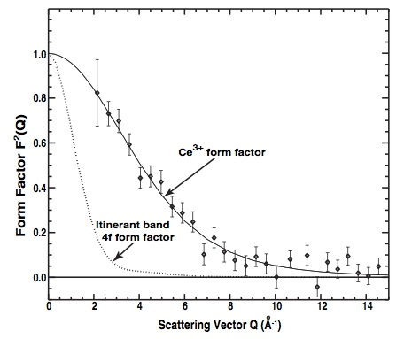
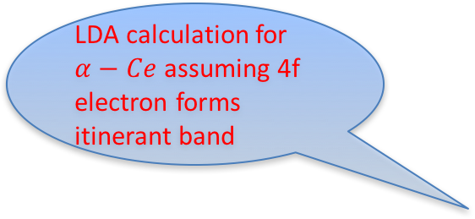

The form factor puzzle for $α−Ce$
Murani et.al (PRL 95, 256403):
Form factor remains unchanged across transition
LDA calculation for $α−Ce$ assuming 4f electron forms itinerant band
4f electrons remain correlated across the transition.
Disagrees with DFT!

Slide 18
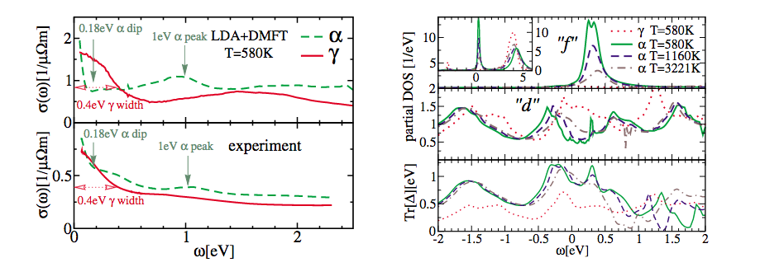
DMFT solves puzzle for formfactor
DMFT results in perfect agreement with experiment!
DMFT already explained DOS and optical conductivity data
Haule et.al, PRL 94, 036401 (2005)

Slide 19
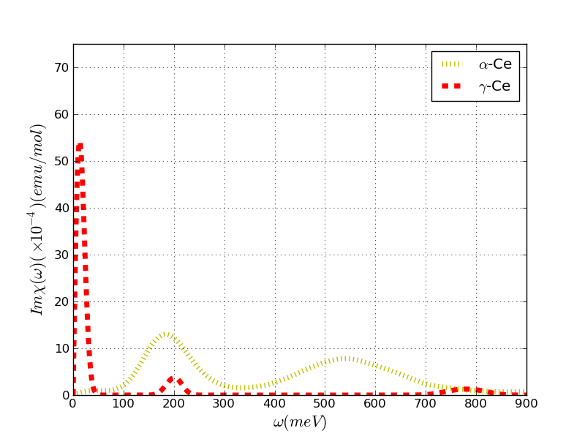
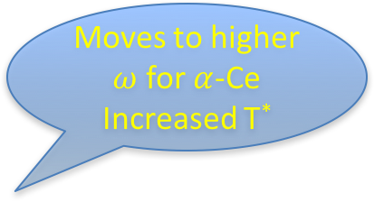
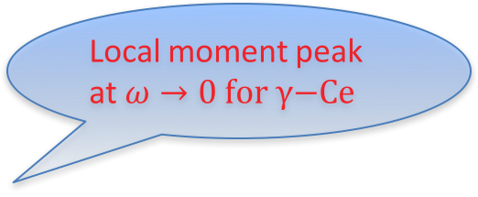

DMFT results for $χ”(ω)$
Local moment peak at $ω→0 \text{for} γ\text{−}\text{Ce}$
Increased Hybridization
Moves to higher $ω$ for $α$-Ce
Increased T*

Slide 20
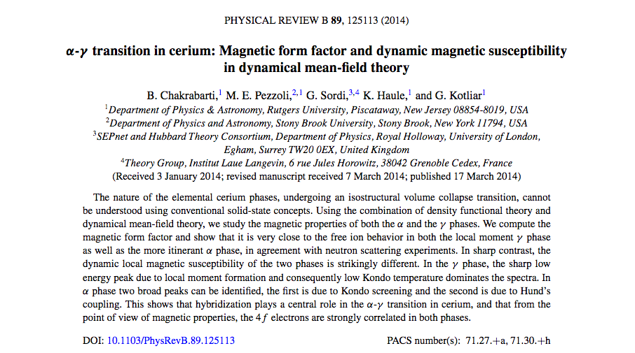
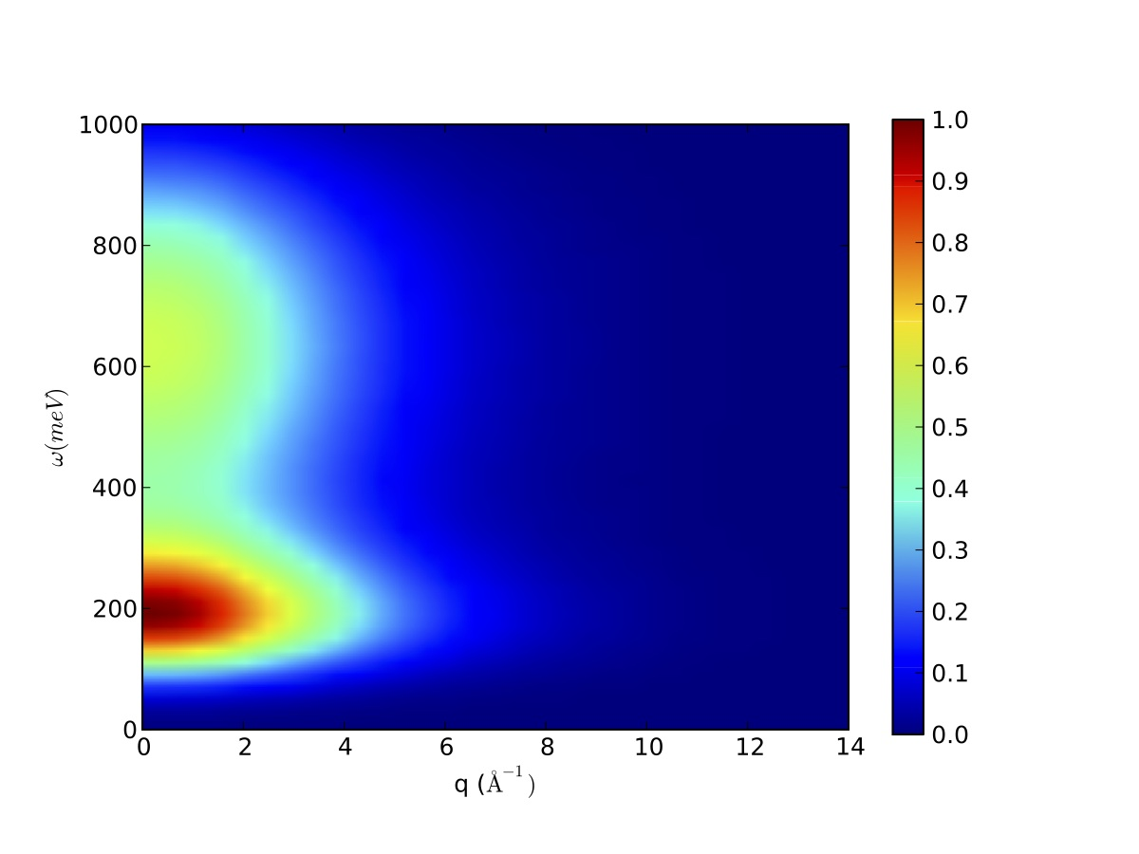
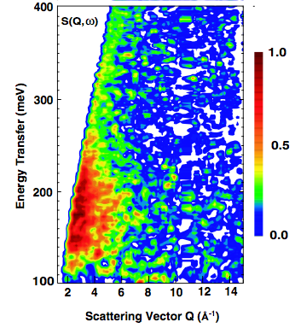

DMFT results for $S\left(q,ω\right)$
Very Good
Agreement!

Slide 21
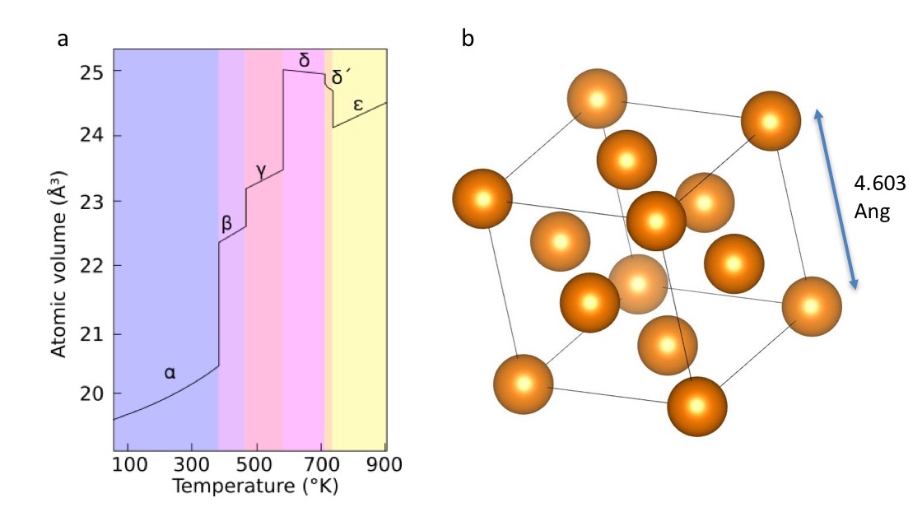
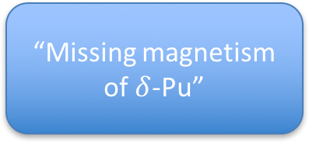

The valence fluctuating ground state of $δ$-Pu
Theories which reproduce unit cell volume predict static moment
Plutonium has a highly complex phase diagram.
Pauli Susceptibility,
Anomalously high C_{v}
Experiments disagree! Early experiments found no moment at Room Temo
“Missing magnetism of $δ$-Pu”

Slide 22
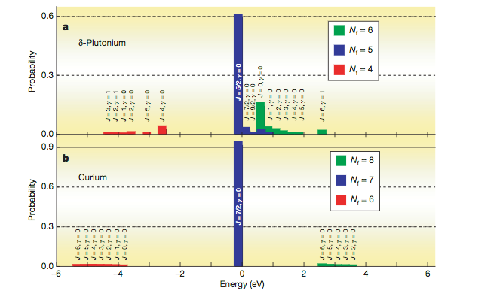
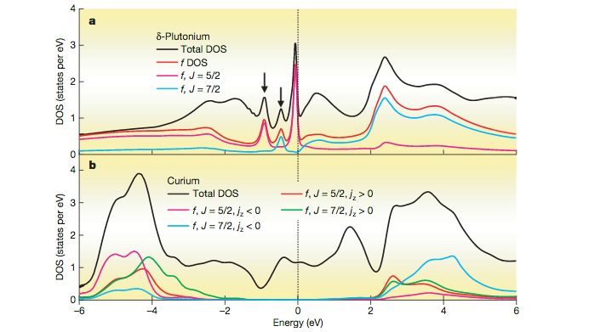
Early DMFT Successes
Earlier work using DMFT had already achieved good results for DOS and hinted at valence fluctuations being important
Haule et.al Nature 446, 513-516 (2007)

Slide 23
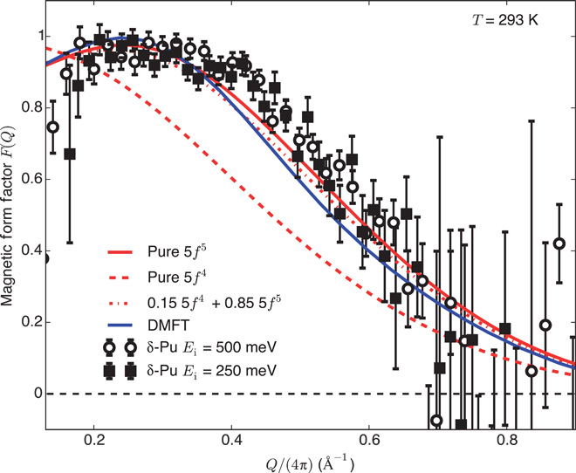
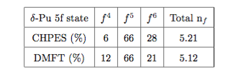
Magnetic Form Factor & Valence fluctuations
Large fluctuations in occupation of 5f orbital- captured by DMFT
Janoschek et. al. Science Advances, 1(6),
2015.

Slide 24
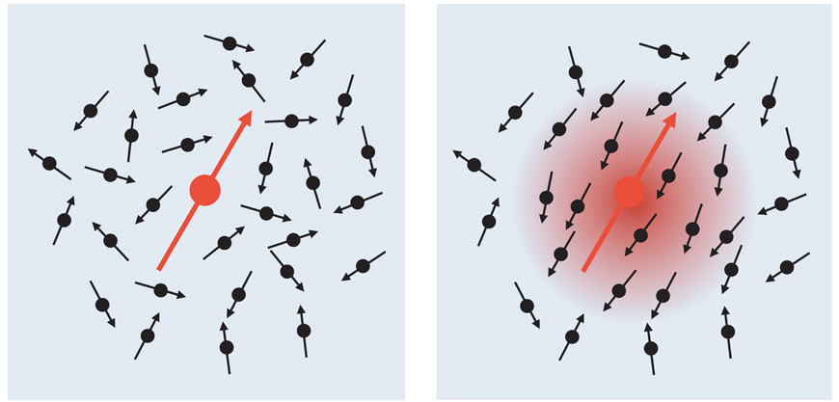
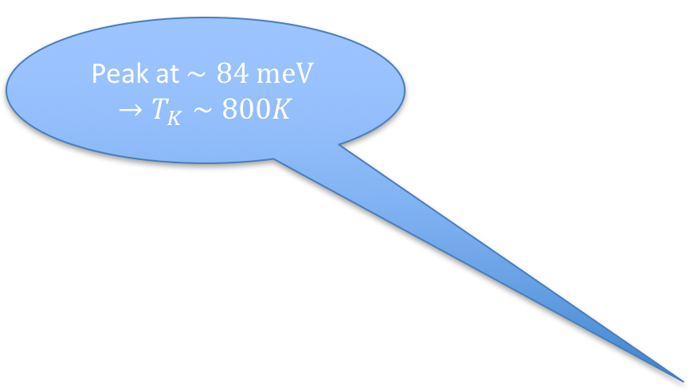
The Missing magnetism
At room Temperature Magnetic moment is screened by Kondo cloud
Peak at $∼84 \text{meV} →T_{K}∼800K$
T>T_{K}
T<T_{K}

Slide 25
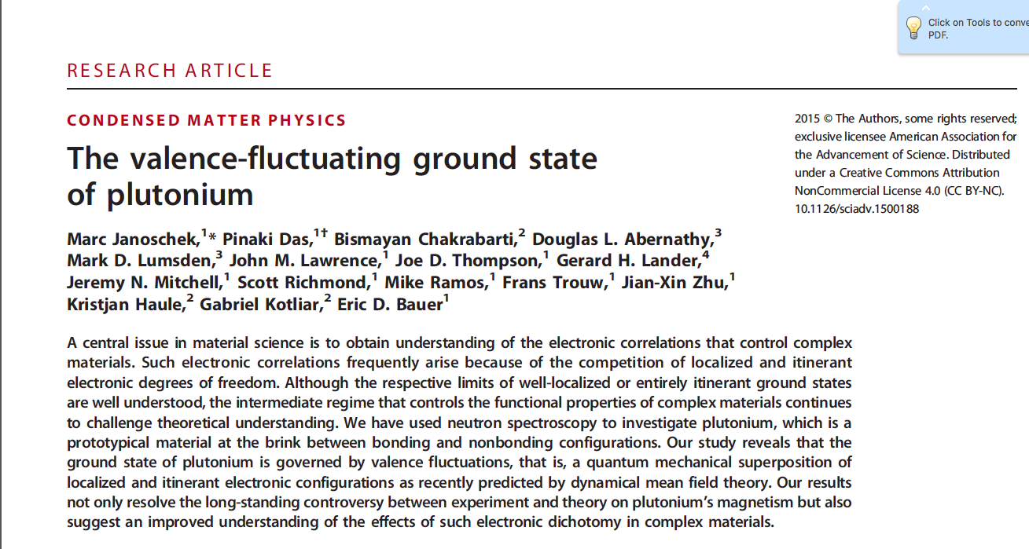
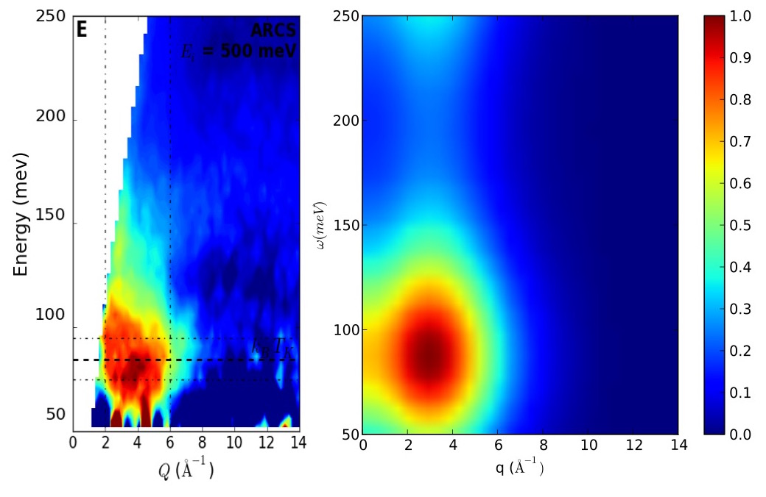

DMFT Results for $S(q,ω)$
Very Good
Agreement!

Slide 26

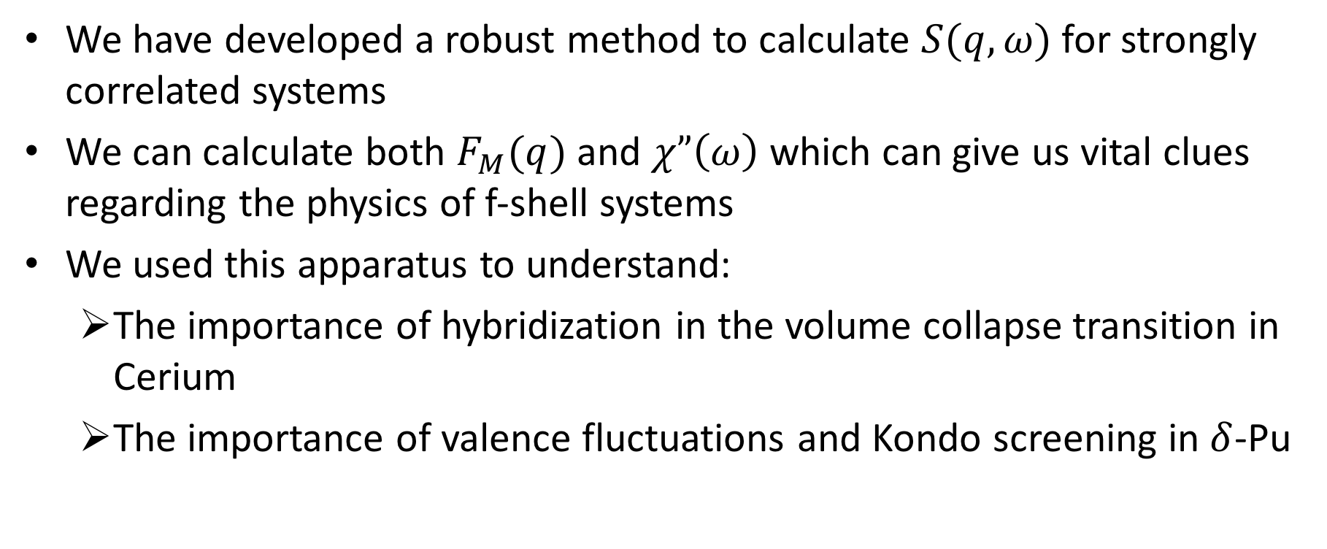
$S(q,ω)$ Conclusions
We have developed a robust method to calculate $S(q,ω)$ for strongly correlated systems
We can calculate both $F_{M}(q)$ and $χ”\left(ω\right)$ which can give us vital clues regarding the physics of f-shell systems
We used this apparatus to understand:
The importance of hybridization in the volume collapse transition in Cerium
The importance of valence fluctuations and Kondo screening in $δ$-Pu

Slide 27
Spin state Transition in LaCoO₃

Slide 28
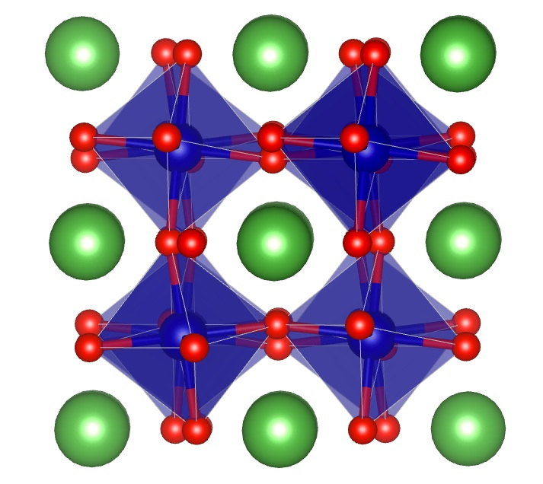
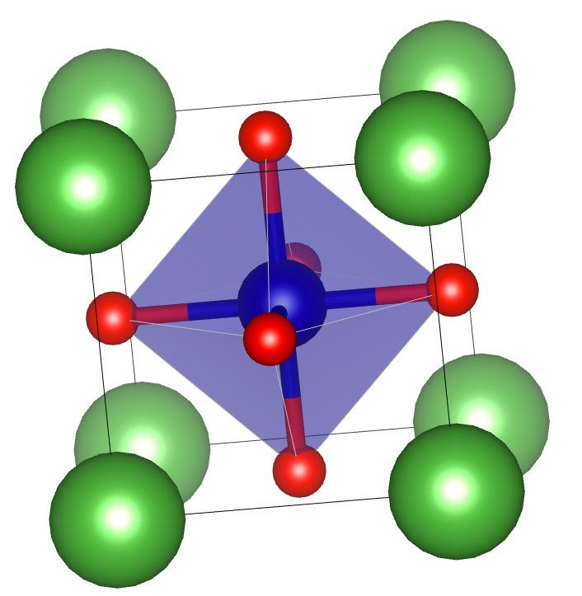
Why LaCoO₃?
LaCoO₃ is a perovskite (ABO₃) with La on the A site and Co on the B site surrounded by Oxygen Octahedra.
The Octahedra undergo out of phase rotations along the [111] axis (a⁻a⁻a⁻ tilt pattern)
Narrow band-gap insulator at low temp (<60K) with Pauli-like susceptibility.
Between 90-150 K, transitions to a local moment phase with Curie-Weiss like susceptibility. Gradual closing of the insulating gap, known to be metallic above 600K.
O
La
Co

Slide 29
Why LaCoO₃?(contd..)
The main puzzle is to determine the spin state of the nominally 3d⁶ Co ion which characterizes the local moment phase at high temperature.
Much disagreement between theoretical approaches. Experiments have also not been able to unambiguously settle the issue
Must also explain the non-concurrent metal-insulator transition taking place at higher temperature than spin state transition.
e_{g}
e_{g}
t_{2g}
t_{2g}
(“ Low to Intermediate Spin”)
(“ Low to High Spin”)

Slide 30
Structures studied
To study the effects of octahedral rotations and thermal expansion on the transitions, we study 4 different structures
Structures from neutron scattering experiments (Thornton et. al).
Low Temperature Structure at 4 K (LTa⁻ structure).
High Temperature Structure at 1143 K (HTa⁻ structure)
Fictitious Structures with no octahedral rotations (a⁰a⁰a⁰ pattern)
With same lattice vectors as 4K structure (LTa⁰ structure)
With same lattice vectors as 1143 K structure (HTa⁰ structure)
For all 4 structures we perform simulations at temperatures between 116K and 1160 K.

Slide 31
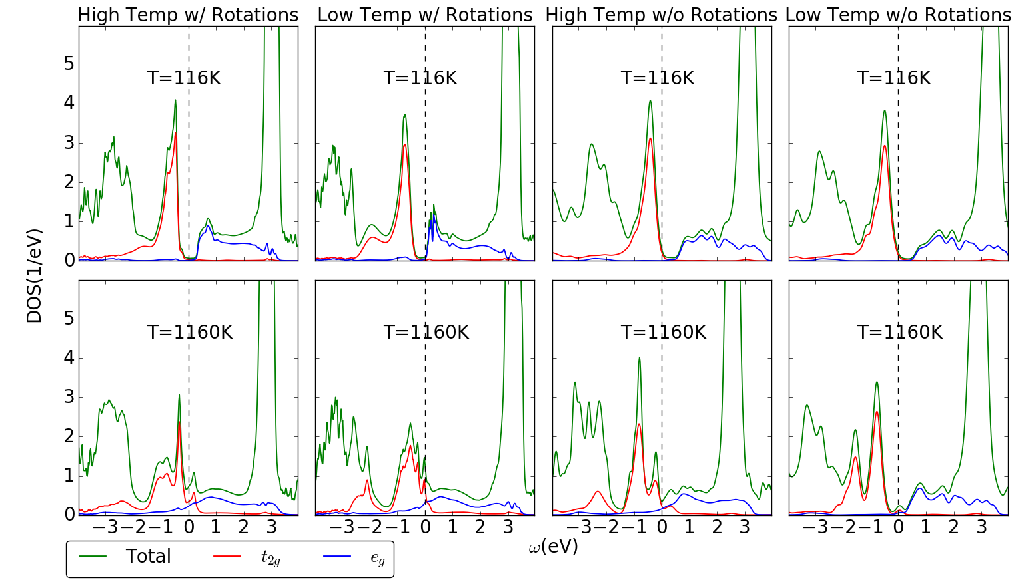
Density of States
MI Transition
MI Transition
MI Transition
No Transition

Slide 32

The Spin State Transition!!
Transition Temp higher than Expt!
Earliest & Strongest Transition in HTa⁻
Almost NO Transition in LTa⁰

Slide 33
Non-concurrent Transitions!!
T_{ss} HTa⁻
T_{MIT} HTa⁻

Slide 34




Which Multiplet is to blame?
T_{ss}
T_{ss}
HTa⁻
LTa⁻
HS excitation
HS excitation
n_{d}=6.6! Large valence fluctuations
T_{ss}
T_{ss}
HTa⁰
LTa⁰
HS excitation
HS excitation

Slide 35
Importance of Electronic Entropy
According to entropy driven scenario, LaCoO₃ prefers higher spin multiplets due to Entropy gain.
To test effect of structural factors on electronic entropy we compute the Entropy difference between LTa⁻ and HTa⁻ structures at 1160K using state of the art Entropy calculation technique(Birol et.al)
Gain in T•S of 110 meV per formula unit in Hta⁻ compared to LTa⁻ structure. Stabilizes HTa⁻ structure
Shows that electronic entropy is vital in stabilizing the thermal expansion and driving the spin state transition in the material.
HTa⁻
LTa⁻
F=E-T•S
Energy
(E)
Free Energy
(F)
LTa⁻
HTa⁻
1160K

Slide 36
LaCoO₃ Conclusions
Obtained non-concurrent spin state and metal-Insulator transitions. However spin state transition occurs at slightly too high temperature.
Determined that HS state is the first to get excited at the onset of the spin state transition for all occupancy sectors.
Larger octahedral rotations and lattice expansion favor the spin state transition.
Studied the importance of electronic entropy and found it to be essential in driving the structural transitions in the material.
Currently in review process: arXiv:1605.08611

Slide 37
Conclusions
Strongly correlated compounds display a range of very interesting phenomena currently being studied in condensed matter.
DMFT (especially when combined with DFT) provides a robust tool to investigate the properties of correlated systems
DFT+DMFT allows us to calculate a wide range of observables which allows us to make comparisons with many different experiments.
It is hoped that with continued advancement in algorithms and hardware, we will soon be able to solve the inverse problem of computational material design.

Slide 38
Thank You

Slide 39
Inadequacy of cRPA in estimating screening in Strongly Correlated systems

Slide 40
The Parameter Problem
Interaction between electrons in the impurity solver typically parameterized by U and J in simulation techniques like DFT+DMFT.
We should have ab-initio method to reliably estimate these material specific parameters.
In practice, they are often treated as free parameters to be decided either “by experience” or in order to achieve agreement with particular observables.

Slide 41
A possible solution: cRPA
Constrained Random Phase Approximation (cRPA) has become popular in recent times to estimate these parameters.
Advantages:
Material Specific
Clear picture of the screening mechanisms taken into account
Has been applied to DFT+DMFT simulations of strongly correlated systems like transition metal oxides and Lanthanides.

Slide 42


So how does cRPA work?
Factor in screening by all the itinerant (bands not treated using DMFT) in an RPA-like fashion.
Basic Screening unit is the “Polarization Bubble”
U and the fully screened interaction W are then given by:
$$P^{αβ}\left(q,ω\right)$$

Slide 43

Issues with cRPA
Even though cRPA has gained popularity in recent years, it is often found to predict values not suitable for DFT+DMFT calculations.
Often predicts values of U far lower than those required by DFT+DMFT impurity solvers to achieve agreement with experiment¹.
RPA diagrams might not be the most important ones in the screening of local U. (RPA applicable when $q→0$).
Other issues such as violation of the Pauli Principle.
¹Amadon et. al, Phys. Rev.B 89, 125110 (2014)

Slide 44



Non-interacting DOS and Band Structure of the 2 models
d orbital- strongly correlated
Hybridized with weakly correlated p/s orbitals
2-orbital (dp) model
$$U_{dp}=0.8 U_{dd}$$
$$U_{pp}=0.2 U_{dd}$$
dp model
3-orbital (dps) model
$$U_{dp}=0.6 U_{dd}$$
$$U_{pp}=U_{ss}=U_{ps}=0.1 U_{dd}$$
$$U_{ds}=0.5 U_{dd}$$
dps model

Slide 45



Overscreening in cRPA
$Z_{d}\left(∝\frac{m_{e}}{m^{∗}}\right)$ in both models clearly shows systematic overscreening in cRPA
dp model
dps model
Gross Overestimation of critical U by cRPA
No Mott transition in cRPA

Slide 46


DOS for dp model at U_{dd}=4.5
No Mott transition in cRPA

Slide 47


Dos for dps model at U_{dd}=6.0
No Mott transition in cRPA

Slide 48


An attempt at an alternate formulation
We formulated a new scheme where the RPA polarization was replaced by the full local DMFT polarization $P^{loc}$ including all local interactions exactly.
$P^{loc}$calculated from the impurity charge and spin susceptibilities calculated using CTQMC.
Also restores Pauli principle!

Slide 49

DOS for dp model with “cLoc”
cLoc captures Mott Transition

Slide 50

DOS for metallic solution with cloc
cLoc captures Mott Transition

Slide 51
Conclusions for Project
We see that cRPA systematically overscreens the local coulomb repulsion and hence might give U values unusable for DMFT
The extent of overscreening is also hard to estimate, making the error hard to get rid of
Our results also show that it is possible to open up a gap in the pd model without an inter-orbital U, contradicting Hansmann et al (New Journal of Physics 16, 033009 (2014))
We also examine a new scheme involving the local Polarization which predicts values of Hubbard U which are more accurate in reproducing the spectra of the full model, especially near the Mott Transition.

